Slide 1
Numerical Analysis
Fixed Point Iteration Method
Lab5

Slide 2
PROGRAM fixpt.m
function [k,p,err,s] = fixpt(g,p0,tol,max1)
% Input - g is the iteration function - p0 is the initial guess for the fixed-point
% - tol is the tolerance - max1 is the maximum number of iterations
% Output - k is the number of iterations that were carried out
% - p is the approximation to the fixed-point
% - err is the error in the approximation - s‘ contains the sequence {pn}
s(1)= p0; % s=[ s(1) s(2) s(3) ……………..]
for k=2:max1 % k=[2 3 4 5 6 7 8 …….…max1]
s(k)=feval(g,s(k-1)); % g is being evaluated at s(k-1)
err=abs(s(k)-s(k-1)); % abs is absolute value and calculate error
p=s(k);
if (err<tol)
break;
end
end
if k == max1
disp('maximum number of iterations exceeded')
end
s=s'; % s’ is the transpose of s

Slide 3
Fixed Point Example 1
Define a function in g.m file
  function y=g(x)
  y=cos(sin(x));
Draw the graph of g(x) and y=x in command window.
>> x=-1:.01:1;
>> fplot('g', [-1 1])
>> y=x;
>> hold on
>> plot(x,y);
Check where the fixed point lies in [0.6 0.8]

Slide 4
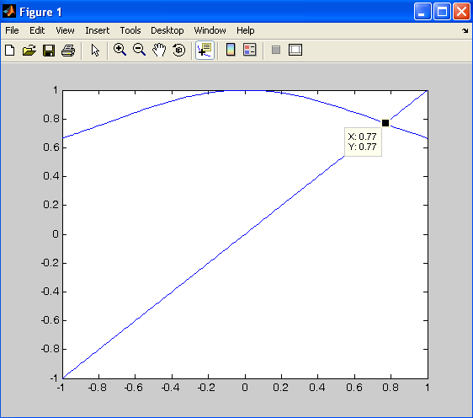

Slide 5
Fixed Point Example 1
To find the sequence will converge or not
How to find derivative of g(x)
>> syms x
>> diff('cos(sin(x))')
ans = -sin(sin(x))*cos(x) %derivative of function
>> abs(subs(diff('cos(sin(x))'),0.7))
ans = 0.4593 % |g’(x)|<1 at 0.7
>> abs(subs(diff('cos(sin(x))'),0.8))
ans = 0.4580 % |g’(x)|<1 at 0.8
>> abs(subs(diff('cos(sin(x))'),0.75))
ans = 0.4610 % |g’(x)|<1 at 0.75
>> |g’(x)| <1
The sequence will converge

Slide 6
Fixed Point Example 1
>>[k,p,err,s]=fixpt('g',.7,1e-13,1e+6)
k = 38 % no of itrations
p = 0.76816915673682 % solution
err = 7.449596495234800e-014 %error
s = %Sequence
0.70000000000000
...............................
0.76816915673682
To check the solution of x-g(x)=0
>>p=g(p)
>> g(0.76816915673682)
ans = 0.76816915673678

Slide 7
Fixed Point Example 2
Define a function
  function y=g(x)
  y=x^5-3*x^3-2*x^2+2;
Draw the graph of g(x) and y=x.
>> x=-3:0.0001:3;
>> y=x;
>> plot(x,y)
>> hold on
>> fplot('g',[-1 1])
Check what happen if change the range to [-3 3]
Check where the fixed point lies in [0.6 0.8]

Slide 8
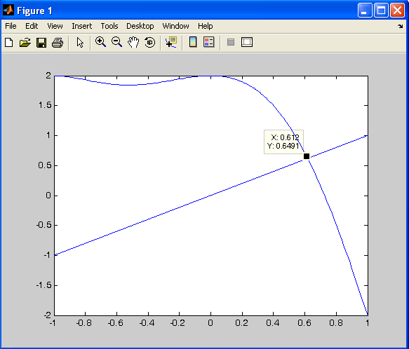

Slide 9
Fixed Point
To find the sequence will converge or not
How to find derivative of g(x)
>> syms x
>> diff('x^5-3*x^3-2*x^2+2')
ans = 5*x^4-9*x^2-4*x %derivative of function
>> abs(subs(diff('x^5-3*x^3-2*x^2+2'),0.7))
ans = 6.0095 % |g’(x)|>1 at 0.7
>> abs(subs(diff('x^5-3*x^3-2*x^2+2'),0.8))
ans = 6.9120 % |g’(x)|>1 at 0.8
>> abs(subs(diff('x^5-3*x^3-2*x^2+2'),0.6))
ans = 4.9920 % |g’(x)|>1 at 0.6
|g’(x)|>1
The sequence will not converge

Slide 10
Fixed Point
>> [k,p,err,s]=fixpt('g',.7,1e-4,1e+2)
maximum number of iterations exceeded
k = 100
p = NaN
err = NaN
s =
1.0e+084 *
0.00000000000000
0.00000000000000
  ...............................
  -Inf
  NaN

Slide 11
Assignment 1
Question No.1 Page 61 of Text book
Submission Contains the following at \\csdept\data\Assignments\Mr. Kabeer Ahmed\BESE14 (A or B)\Fixpt
  Graph of function y=x and y=g(x)
  Identify the intervals where roots are lying
  Apply fixed point algorithm to find the fixed point
  Explain the reasons for failure of program

